Slide 1
Introduction to .NET
Frank McCown
TechLunch
Old Dominion University
March 28, 2007

Slide 2
Before .NET
Windows GUI development: Win32 API, MFC, Visual Basic
Web development: ASP
Java – “Write once, run anywhere.”
Embrace and extend: Visual J++
Notes:
MFC was introduced in 1992.
VB created in 1991. Replaced by VB.NET. MS stopped supporting VB in 2005.
ASP first developed in 1996. Used VBScript.
“Write once, test everywhere.” – Hooks to OS or hardware specific devices means Java code must be changed.

Slide 3
.NET Framework
First developed by Microsoft in 2000
Current version (3.0) released in Nov 2006
Targets primarily Windows OS, but Mono Project (headed by Novell) supports Linux, Unix, FreeBSD, Mac OS X, Solaris
Primary languages: C#, Visual Basic .NET, C++/CLI, and J#
Third-party languages: Ada, COBOL, LISP, Perl, Ruby, and many more
Notes:
C#'s principal designer and lead architect at Microsoft is Anders Hejlsberg who also developed Turbo Pascal, Borland Delphi, and Visual J++.
C++/CLI (Common Language Infrastructure) supersedes managed C++. It contains new syntax that helps clarify if using managed or unmanaged memory.
http://en.wikipedia.org/wiki/C%2B%2B/CLI
Managed vs. unmanaged code. What is the advantage of running managed code? Of running unmanaged code?

Slide 4
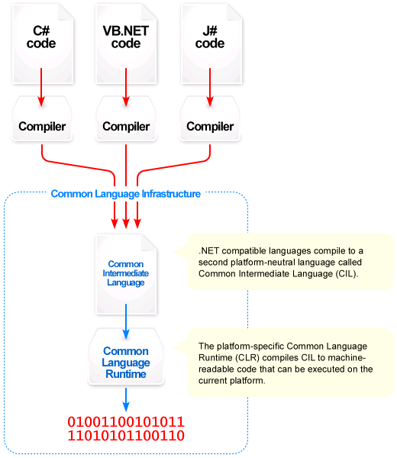
http://en.wikipedia.org/wiki/Image:Overview_of_the_Common_Language_Infrastructure.png
Notes:
CIL is also called MSIL (Microsoft Intermediate Lang)

Slide 5
Comparison to Java
Hello.java
Hello.class
JVM
compile
execute
Source code
Byte code
Hello.vb
Hello.exe
CLR
compile
execute
Source code
CIL
Notes:
Byte codes are interpreted by the JVM or JITted before being executed. CIL is JITted into object code which is executed by the CLR.

Slide 6
Hello, VB.NET!
.method public static void Main() cil managed
{
.entrypoint
.custom instance void [mscorlib]System.STAThreadAttribute::.ctor() = ( 01 00 00 00 )
// Code size 14 (0xe)
.maxstack 8
IL_0000: nop
IL_0001: ldstr "Hello VB.NET!"
IL_0006: call void [mscorlib]System.Console::WriteLine(string)
IL_000b: nop
IL_000c: nop
IL_000d: ret
} // end of method Hello::Main
Module Hello
Sub Main()
Console.WriteLine("Hello,
VB.NET!")
End Sub
End Module
ildasm Hello.exe

Slide 7
Helpful Resources
Comparison of Java vs. C#
http://en.wikipedia.org/wiki/Comparison_of_C_Sharp_and_Java
http://www.harding.edu/fmccown/java1_5_csharp_comparison.html
Comparison of VB.NET vs. C#
http://en.wikipedia.org/wiki/Comparison_of_C_sharp_and_Visual_Basic_.NET
http://www.harding.edu/fmccown/vbnet_csharp_comparison.html

